Slide 1
White-Rodgers 50D50U-843 All-Spark Universal Intermittent Pilot/Direct Spark Ignition Module
Including the White-Rodgers F67-8535 Integrated Thermostat Sensor

Slide 2
Business and Product Overview

Slide 3

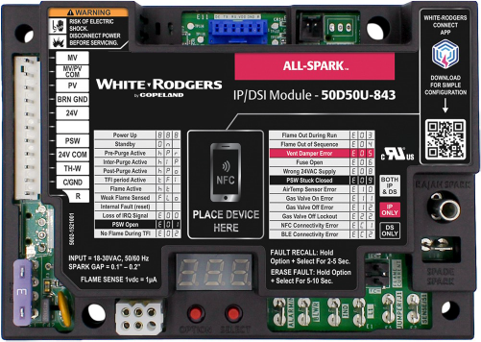
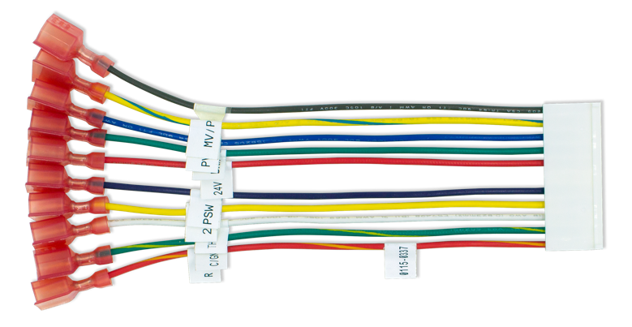
White-Rodgers All-Spark Ignition Module
    The 50D50U-843 is the first universal replacement
    for 24V intermittent pilot or direct spark ignition that utilizes a mobile app for configuration and diagnostics.
      Replaces over 600 IP and 400 DSI part numbers.
    Various configuration and mounting options.
    Configurable on the control OR via near-field communication (NFC) and the White-Rodgers Connect app.

Slide 4
All-Spark Ignition Module Control Features
Integrated Thermostat Sensor Connector
11-pin In-line Connector
Pressure Switch Connection
Near-field Communication (NFC)
Optional Rajah spark plug or ¼" Spade
Serviceable Fuse
Flame Sense Test Pins
Vent Damper Connector
Alarm Output Connection
Local/Remote Flame Sense Connections​
3-Digit
7-Segment LED Display
Inducer Connection

Slide 5


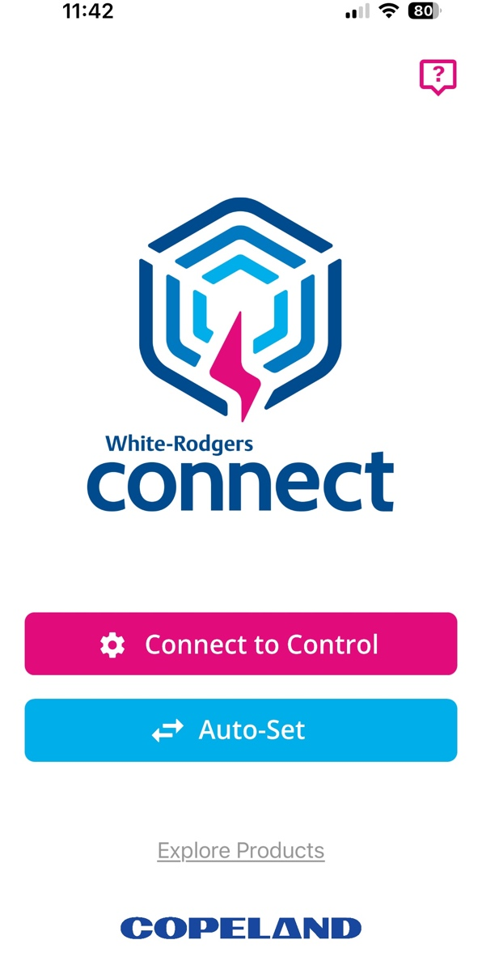
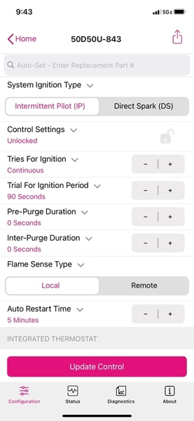
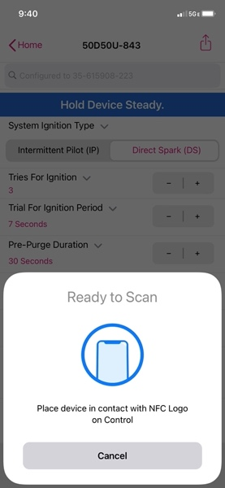
Introducing White-Rodgers Connect
    App provides simple configuration without power prior to installation.
    No login or username required.
    Configure with preloaded OEM settings or customize module configurations.
    Diagnose fault codes and troubleshoot confidently.
    View status and details about the module.
Near-field Communication (NFC) creates an interface between the control and your mobile device with the White-Rodgers Connect app. Just place your mobile device on the control to enable a connection.
Once downloaded, the White-Rodgers Connect app does not require cellular/Wi-Fi service to use.

Slide 6
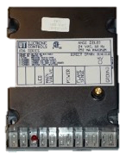
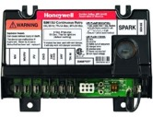
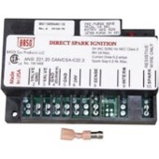
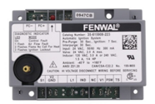
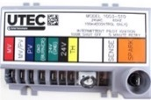
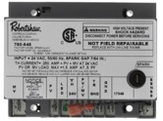
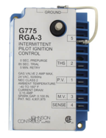
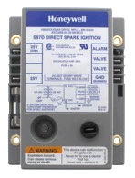
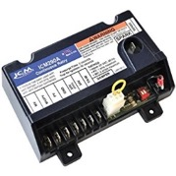
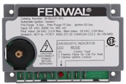
All-Spark Ignition Module Applications
Intermittent Pilot (IP or Proven Pilot)
Direct Spark (DSI)
    Systems with gas valves that have both a pilot valve & a main valve use these brands
    Systems with gas valves that only have a main valve use these brands
Honeywell
S8610U
UTEC
1003
Robertshaw
780
BASO
C107U
UTEC
1016
Fenwal
35-60/61
ICM
290A
Johnson
G60/65/67/77
Fenwal
35-63
Honeywell
S87

Slide 7
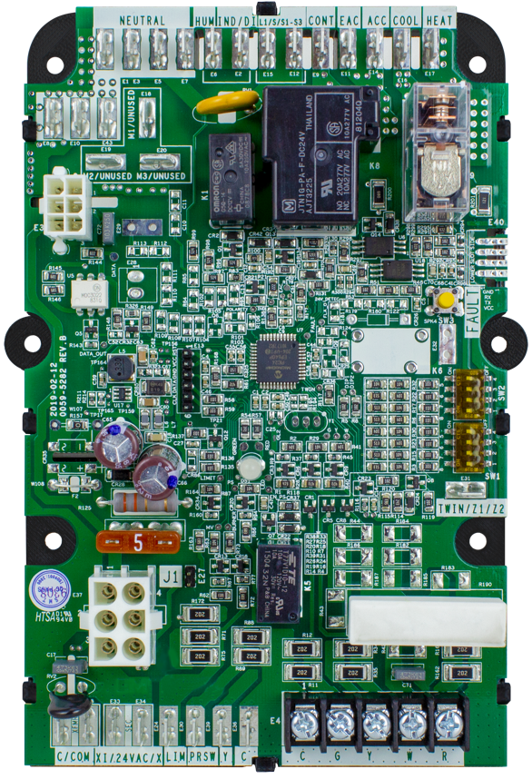
Non-Integrated Furnace Application
What is “Non-Integrated”?
    A Non-Integrated Control is a partial control that connects to another for complete operation. For Forced Air Units, the 50D50U-843 will integrate with a 50F06-843 Fan Timer module for complete Furnace operation.
      Most common All-Spark Ignition Module Furnace application!
    All-Spark can be installed in a wide range of applications (continued on the next slide)
PLUS +

Slide 8
Cross References
    All-Spark Ignition Module has 1,000+ cross references
    600+ Intermittent Pilot controls and 400+ Direct Spark Ignition controls
    Annual market is estimated to be over
    500K replacements

Slide 9
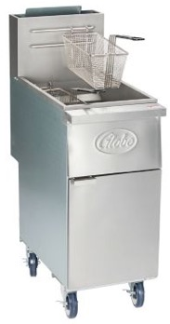
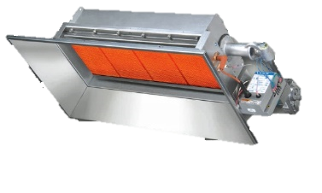
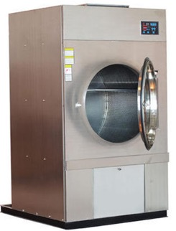
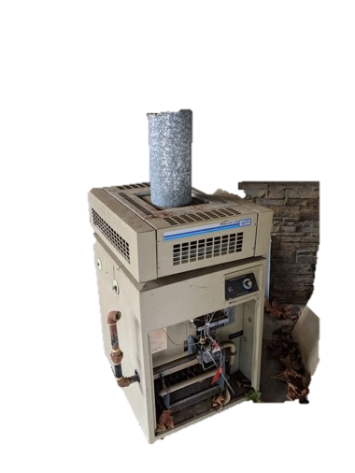
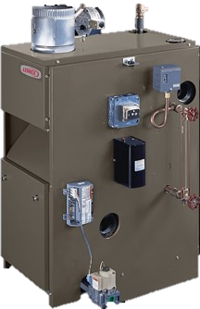
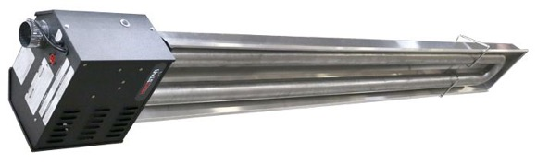
Additional Applications
Stand-alone Applications
  All-Spark Ignition Module can also function as a stand-alone control where no blower is utilized.
Infrared Heater
Gas Dryer
Food Fryer
Gas Boiler
Tube Heater
Pool Heater

Slide 10



All-Spark Ignition Module Benefits
2 Applications in 1
Easy Connections
Mobile Configuration
    Combines Intermittent Pilot & Direct Spark Ignition in one control.
    Full featured connections:
      On-board Vent Damper
      Alarm Output
      Inducer & Pressure
      Switch Inputs
    With Rajah & ¼" spade, the All-Spark Ignition Module connects to the majority of spark wiring.
    24v 11-pin harness has all configuration wires that are made active through personalized configuration.
    Utilizes Near-field Communication for simple configuration.

Slide 11
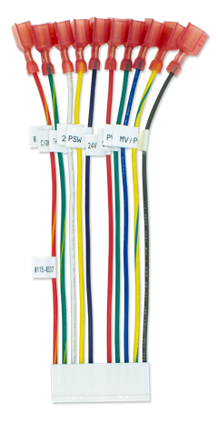

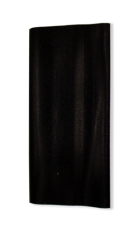

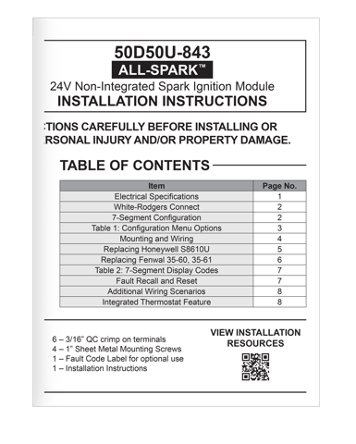
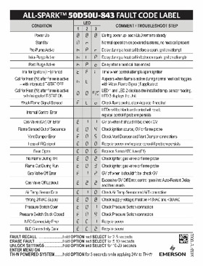
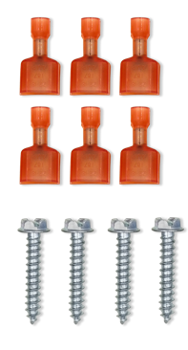
What’s in the Box: 50D50U-843
    50D50U-843 module
    11-pin 24v harness
    Vent damper plug
    Flame sense jumper
    14-16 AWG ¼" female QC spade – nail/spike spark adapters with shrink-wrap sleeve
    6 – 3/16" male QC spade terminals
    4 – 1" mounting screws
    Fault code label
    Instruction sheet with QR code link to install video
    QR code for White-Rodgers Connect app

Slide 12
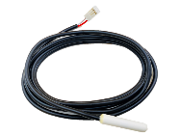
Introducing the All-Spark Integrated Thermostat Sensor
SOLD SEPERATELY
The White-Rodgers F67-8535
Plug-in Temperature Sensor
  The White-Rodgers 50D50U-843 Non-Integrated Spark Ignition Module now can act as a thermostat and turn the module on and off. By connecting the F67-8535 Temperature Sensor to All-Spark, the digital display can be used to show a temperature setting is adjustable using the “Option” & “Select” buttons.
  The Integrated Thermostat feature is designed for infrared & tube heaters that are installed in the area they heat. It can maintain a specific temperature without the system being manually turned on & off or having a separate thermostat installed.
  Features include:
    Plug-in temperature sensor
    Function can be turned on/off in programming
    Easy temperature adjustment
    Display current Setpoint
    Display set temperature
    Adjustable from 40°F to 80°F
F67-8535
Easy to Install, Easy to Configure, Easy to Operate

Slide 13

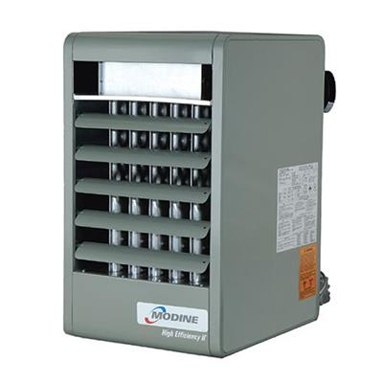
Integrated Thermostat Applications
Fully Independent
    Applications that control the temperature of the space they are in can now be fully controlled at the Unit. By utilizing the All-Spark 50D50U-843 with a F67-8535 Temperature Sensor attached, the thermostat feature allows for a complete self-contained functioning system!
    NOT INTENDED FOR FURNACES.
Tube Heater
+
Space Heater
Infrared Heater

Slide 14
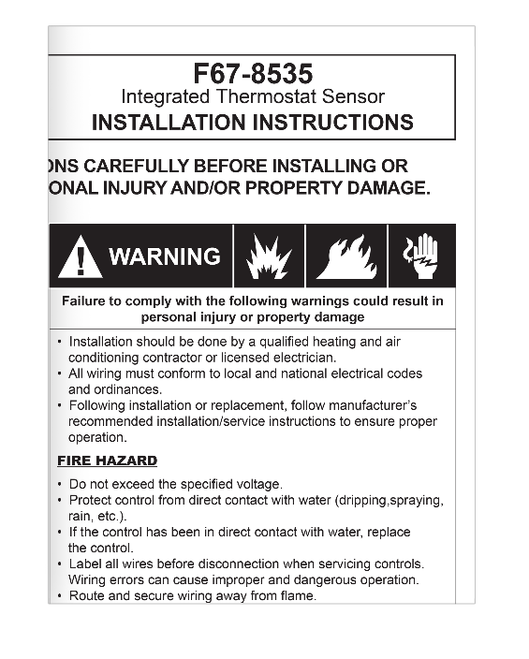

What’s in the Box: F67-8535
SOLD SEPERATELY
    F67-8535 Integrated Thermostat Sensor
    Installation Instructions
    ¼" Female QC Spade Terminal

Slide 15
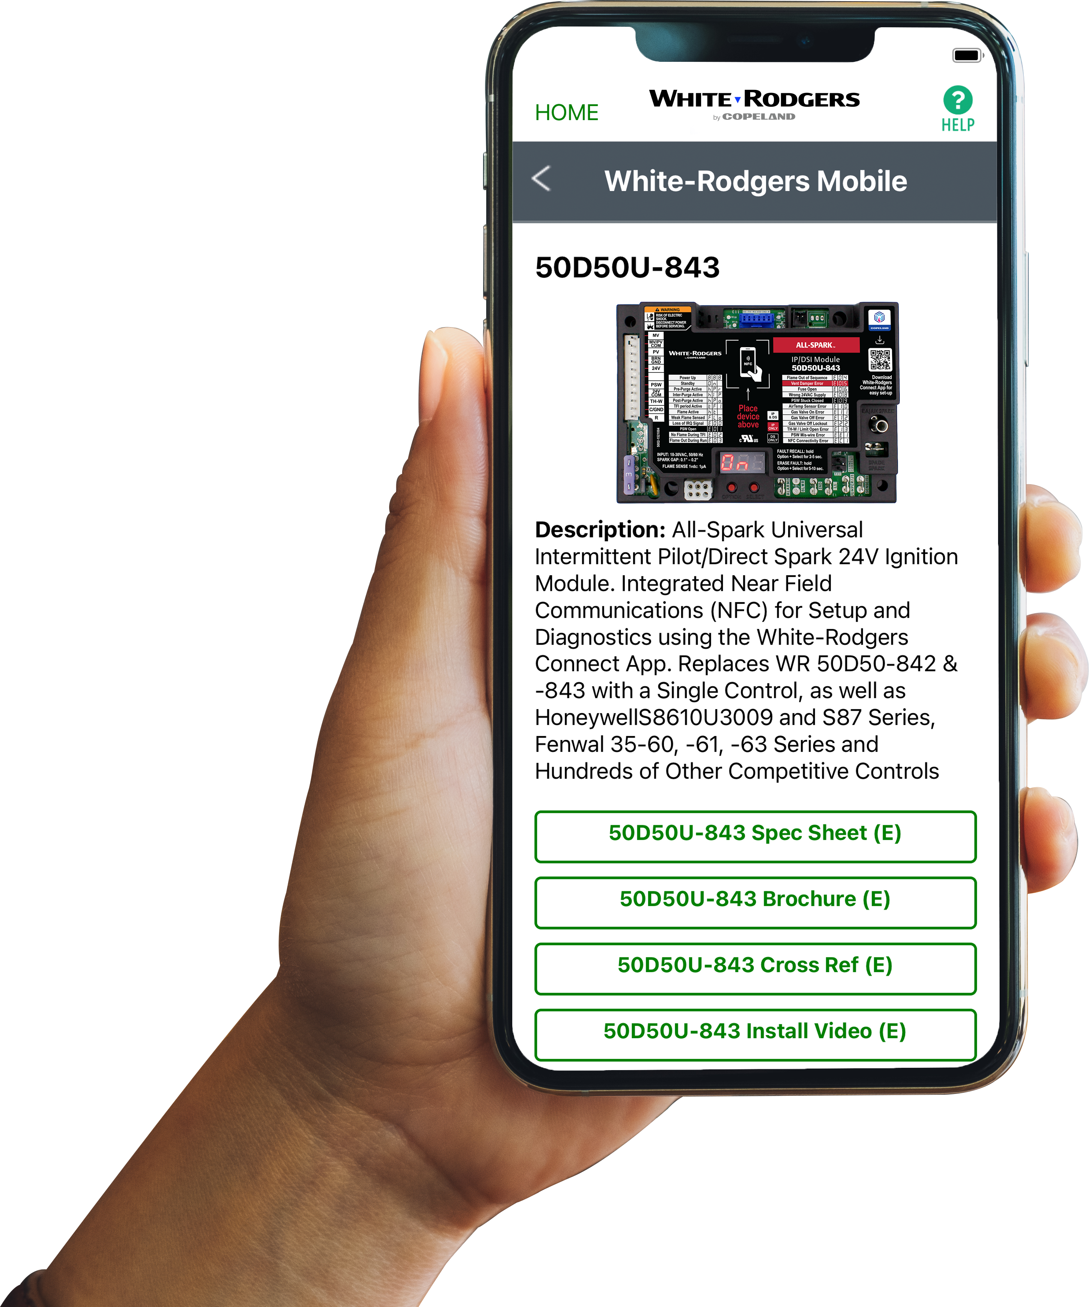



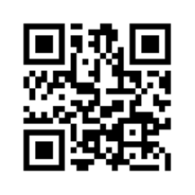
Comprehensive Cross Reference & Product Information
Find the right part while on the job.
  Your on-the-go resource for:
  Complete cross reference
  Product information and spec sheets
  Installation information and videos
  Wiring diagrams
  Select product by features
  Priority technical support
  WR Mobile App
  Search for “WR Mobile” in both Apple
  and Google Play Stores
  Desktop Version
  Access the online version HERE
Search by OEM, Competitor and White-Rodgers part numbers.

Slide 16
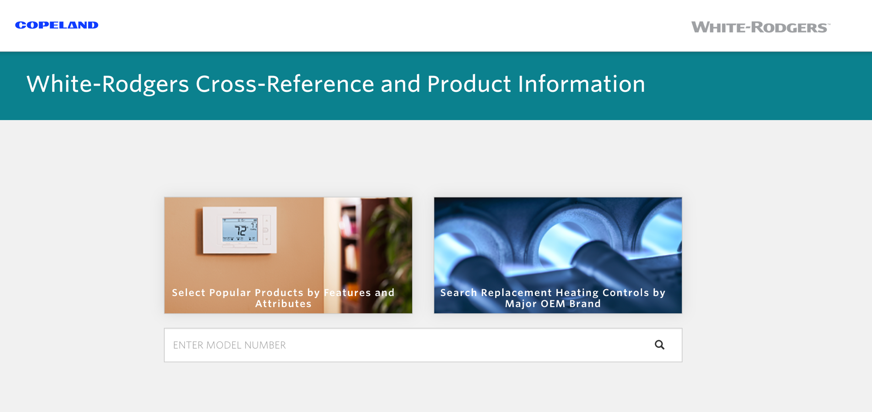
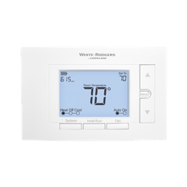
White-Rodgers Cross Reference
  Go to: https://webapps.copeland.com/wrproductselector/
    Enter the Model Number or click on: Search Replacement Heating Controls by Major OEM Brand

Slide 17
Technical Overview

Slide 18
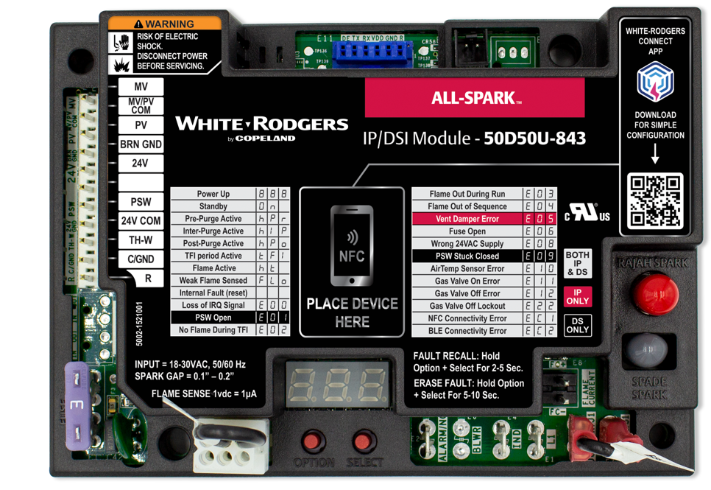
White-Rodgers All-Spark Ignition Module
    The 50D50U-843 is the first universal replacement
    for 24V intermittent pilot or direct spark ignition that utilizes a mobile app for configuration and diagnostics.
      Replaces over 600 IP and 400 DSI part numbers.
    Various configuration and mounting options.
    Configurable on the control OR via near-field communication (NFC) and the White-Rodgers Connect app.

Slide 19

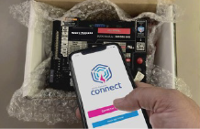
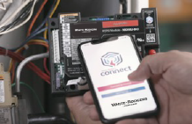
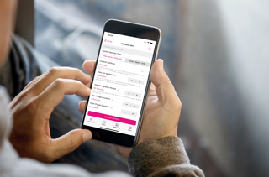


Understanding Near-field Communication
Powering
Connecting
Configuring
Updating
NFC does not require a cellular connection, simply hold the mobile device on the NFC icon until a check mark appears.
Once the control is read, you may move your phone away to configure in the app.
Configuration settings can be uploaded to the All-Spark Ignition Module prior to powering up the control.
Configure from a service truck and even prior to installation.
After configuring, tap the “Update Control” button and hold the device on the NFC icon. Make sure to wait for a check mark, to secure your settings!

Slide 20
All-Spark Ignition Module Components
24v Components:
    11-pin In-line Wiring Connector
    Low Voltage Fuse
    Vent Damper Plug
    Alarm Output Spade
    Bluetooth Connector*
    Remote Thermostat Sensor Connector
120v Components:
    Line 120v Input Spade
    120v Inducer Output Spade
5
6
1
2
3
4
8
7
6
* Planned for release in 2022/2023

Slide 21
All-Spark Components
Other Components:
    Flame Sense Jump Spade
    Flame Sense Spade
    Honeywell (S8600)
    or Fenwal (35-60) Mounting Options
    Rajah or ¼" Spade Connectors
    Flame Sense Test Pins
    Near-field Communication Connect Area
    3–Seven Segment Status/Fault LEDs
    Options/Select Buttons
3
3
6
4
7
5
3
3
8
1
2
6

Slide 22

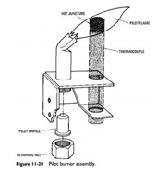
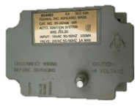
Spark Ignition in Residential Furnace Applications
Dante Raso of Brooklyn, NY, invents the Standing Pilot light system
An Intermittent Spark Ignition system is introduced to replace Standing Pilot systems
Emerson Electric Co. invents & patents the concept of Direct Spark Ignition at burners, eliminating the need for a pilot
The National Appliance Energy Conservation Act set a minimum of 78% Annual Fuel Utilization Efficiency (AFUE)
Manufactures stop building furnaces with Standing Pilot light ignition systems
Most* manufactures have switched from Spark ignition, Silicon Carbide & 80v Nitride to 120v Nitride
* Exception: Rheem still uses Direct Spark Ign.
1928
1968
1987
1984
2006
Era of Forced Air Furnace Spark Ignition Systems
    Spark Ignition is the primary option for natural gas and propane furnaces.
    It requires a rapid release of high electrical voltage from an electrical coil.
      Electric is transferred through an insulated wire to a metal rod placed close to a grounded object.
      The electricity jumps the gap to create an electrical arc.
      Gas is released over this arc and is ignited.
Many other applications using Spark Ignition are still being manufactured today

Slide 23
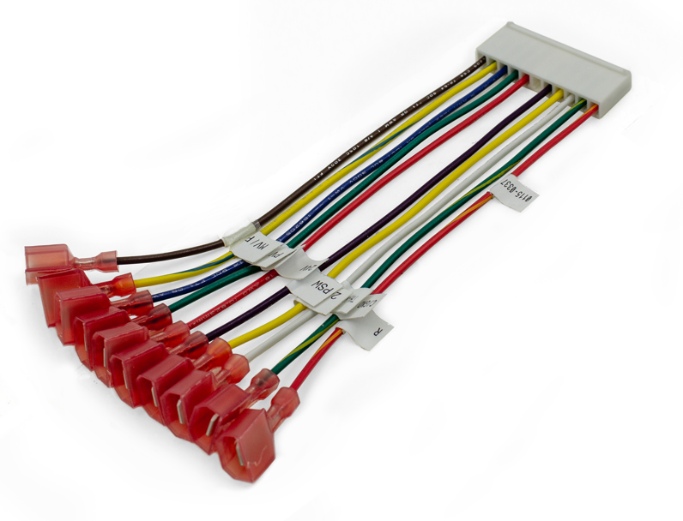
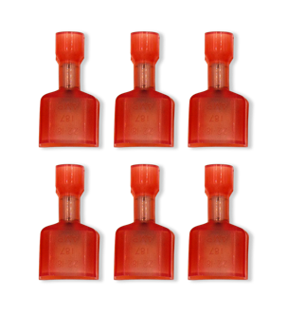
24v 11-Pin Harness
  By providing a harness with ¼" spade connectors, all the wiring can be removed one at a time from the existing control and matched up with the harness labels prior to removing the existing control.
  For some applications, six 3/16" spade connectors are provided.
11-pin Harness Assembly
6 - 3/16" Male QC
Spade Terminals

Slide 24
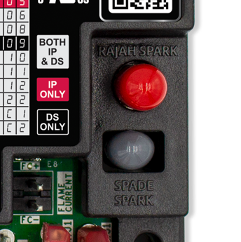
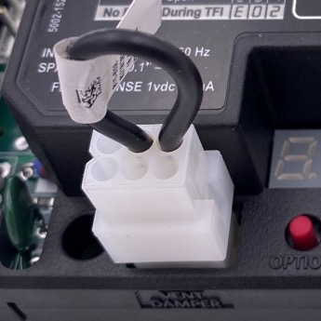
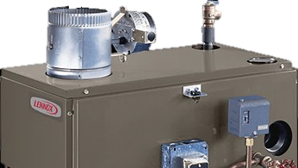
All-Spark Ignition Module Features
Vent Damper with Jumper Plug
Spark Terminal Options
  The vent damper connector is now built in and allows for easy connection to systems that utilize this feature.
  Both Rajah & ¼" spade terminals are built-in.
  A ¼” spade to spike/nail adapter with
  a shrink sleeve is also included.
Terminals come capped. Remove only the cap being used.
Once attached,
an internal fuse allows operation
to begin.

Slide 25
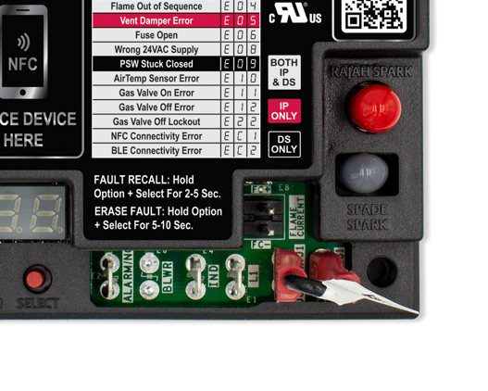
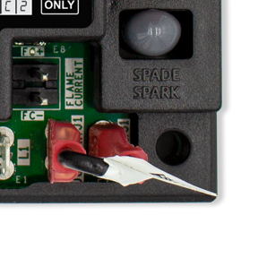
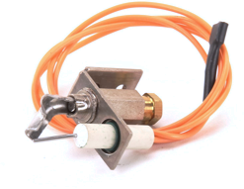
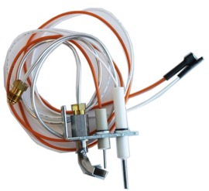
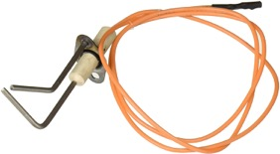

Flame Sense Jumper Feature
Local vs Remote Sense
  Flame sense can be configured to sense the flame through the “Local” spark rod or “Remote” through a separate flame sensor.
  A Local Configuration refers to using a single rod by combining both spark and flame sense in one wire.
  A Remote Configuration refers to using 2 separate rods for the spark and flame sense circuits to operate independently.
or
Use Jumper
Use Sense/S1 Spade

Slide 26


Utilizing the Flame Test Pin Feature
    2 pins extend from the control board to the surface of the cover.
To Test:
    The furnace must have a call for heat and the burners must be producing flame.
    Set a multimeter to vDC and place a meter probe on each pin.
    Convert vDc to MicroAmps using a 1:1 ratio.
    A good flame sense reading will be between
    1.0–5.0 μA.
Test Pins

Slide 27


Intermittent Pilot–TH-W Wire Applications
  Some older IP Modules did not connect to TH-W.
  If the module only connects to 24v & 24v ground, when installing All-Spark Ignition Module connect the wire that was going to 24v to the TH-W wire on the 11-pin harness.
  The 50D50U-843 will power up each time there is a call for heat. No configuration settings are lost.
If 3 wires: connect all 3
If 2 wires: connect 24v(Gnd) & TH-W
All-Spark does not need to be constantly powered

Slide 28


DSI—Inducer & Pressure Switch Options
    When the module is set to Direct Spark Ignition, an option to power an inducer and monitor the system pressure switch is available.
    The module will not allow for system ignition until
    a signal is present on the pressure switch circuit indicating that the switch has closed.
Pressure switch monitoring & 120V inducer power is not available in IP applications

Slide 29

Optional Feature–Alarm Output Terminal
    For applications using an alarm, the ¼” spade labeled ALARM can be connected to the system.
    The alarm circuit normally has an open relay and when initiated will close and supply the alarm spade with 24 volts.
All-Spark can monitor system operation & send out a signal in the event of a lockout condition.

Slide 30


Additional New Features
Bluetooth Capability
  A plug-in module is planned for release in 2022/2023
Integrated Thermostat Sensor
  By connecting a F67-8535 Thermostat Sensor, the 50D50U-843 will be able to function as its own thermostat and maintain a temperature set on the seven-segment display.
White-Rodgers
F67-8535 Thermostat Sensor
SOLD SEPERATELY

Slide 31

Easy-to-Install Mounting Options
Matching Modules Being Replaced
    Four mounting holes are designed to match the board being replaced and give multiple options for alternate mounting.
    4 – ¼" x 1" mounting screws are provided.
White-Rodgers matches mounting holes with competitors’ modules.

Slide 32


Simple Operation of Integrated Thermostat
Integrated Thermostat Adjustable Options
    Set the temperature unit of measurement
      Choose between °F or °C
    Adjust the Sensor reading to accommodate the difference between where the Sensor is located and the area 5–10ft off the floor.
      Temp. Offset -9­°F to +9° ( -5°C to +5°C)
    The Cycle Rate is like a heat anticipator, adjusting how quickly the unit will cycle off based upon how close it is to the Setpoint temperature.
      Slow (longer between cycles), Normal, Fast (shorter between cycles)
The 50D50U-843 Integrated Thermostat has a range of 40°–80°F
    Note: Offset adjustment modifies Room Temperature but does not allow Temperature Setpoint to be manipulated to greater than 80°F (27°C) or below 40°F (5°C).
* Factory Default Setting
** To view/change Set Point value, press OPTION after NO. 3.4 (module exits menu and goes to standby), press OPTION again and the current Set Point will be shown. For further configuration, see Integrated Thermostat section on page 8.

Slide 33


Simple Operation
Integrated Thermostat Operations
On-Board Adjustments
    After configuration, the module enters Standby mode. Room Temperature is then displayed.
    To see the current Setpoint, press the Option button for less than three seconds. The Setpoint temperature will appear.
    Adjust the Setpoint using the Options & Select buttons by pressing them for less than three seconds.
    Save the new Setpoint by holding Select until the LED stops flashing.
Show Setpoint
Increase Setpoint
Setpoint Menu (flashing)
Decrease Setpoint
Setpoint Menu (flashing)
Save Setpoint
Setpoint Menu (to solid)
Flashes during
adjustment
When powered on and in the Standby mode, the 50D50U-843 module LEDs will display the Room Temperature.
    Note: Offset adjustment modifies Room Temperature but does not allow Temperature Setpoint to be manipulated to greater than 80°F (27°C) or below 40°F (5°C)
Decrease Setpoint
Increase Setpoint

Slide 34



Additional Thermostat Display Operations
Normal Operation
Active Errors
    When All-Spark is set up with the Integrated Thermostat enabled and 24v is present at the control:
      Standby mode: The LEDs display the room temperature reading from the sensor.
      Call for Heat: The LEDs will flash between the room temperature sensor reading and ‘ht.’
    During operation, if there are any active errors,
    the LED Display will flash between the room temperature reading and the active error.
e 0 6
8 8 8
7 2 F
8 8 8
8 8 8
7 2 F
h t
8 8 8

Slide 35
50D50U-843 Competitive Comparison
 | Fenwal 35-60, -61 | Honeywell S8610U | W-R All-Spark 50D50U-843
Cross Ref. #s | 1 (individual SKUs) | 425 | 1000+
Ignition Type | DSI | IP | Both in 1
User Configuration |  | Dipswitch | White-Rodgers Connect App or Digital LEDs
Inducer/PSW
Alarm Output
On-board Spark Output | Rajah or Spade | Spade | Rajah and Spade
Flame Current | Test Pins | LED Flash + Test Pins | Test Pins
NFC + App
Integrated Thermostat
The White-Rodgers F67-8535 Integrated Thermostat Sensor now allows All-Spark to maintain a set temperature with-out an additional control!

Slide 36
White-Rodgers All-Spark Ignition Module
    The 50D50U-843 is the first universal replacement
    for 24V intermittent pilot or direct spark ignition that utilizes a mobile app for configuration and diagnostics.
      Replaces over 600 IP and 400 DSI part numbers.
    Various configuration and mounting options.
    Configurable on the control OR via near-field communication (NFC) and the White-Rodgers Connect app.

Slide 37
Installation Overview

Slide 38
What’s in the Box: 50D50U-843
    50D50U-843 module
    11-pin 24v harness
    Vent damper plug
    Flame sense jumper
    14-16 AWG ¼" female QC spade – nail/spike spark adapters with shrink-wrap sleeve
    6 – 3/16" male QC spade terminals
    4 – 1" mounting screws
    Fault code label
    Instruction sheet with QR code link to install video
    QR code for White-Rodgers Connect app

Slide 39

Disconnect Power and Gas
1
  First, ensure the power and gas are disconnected prior to servicing the unit.

Slide 40

Verify Replacement
2
  Check the part number on the existing control
  and verify it is one of the 1,000+ modules that can be replaced with the 50D50U-843. Use the cross-reference on the side of the carton or the
  White-Rodgers Mobile app.

Slide 41

Take a Picture
3
  Take a picture of the existing module for reference before removing any wires.

Slide 42

Note Existing Wiring
4
  Identify the existing wiring and take note of the terminal identifiers on the existing module.

Slide 43


Reference Installation Instructions
5
  Remove the spark wire and locate the 11-pin harness assembly. The installation instructions come with a diagram showing wiring connections for both an Intermittent Pilot system and a Direct Spark system. For this application, the Intermittent Pilot diagram will be used.

Slide 44

Disconnect/Connect Wiring
6
  Individually disconnect each wire from the existing control and connect it to the appropriate Quick Connect terminal on the 50D50U-843 11-pin harness or dedicated spade terminal on the Printed Circuit Board.

Slide 45


Remove Existing Module
7
  Once all of the wires have been transferred, remove the existing module. Take note if there is a ground wire attached to one of the mounting screws.

Slide 46

Configure
8
  The module can be configured using 2 different methods. On-board configuration can be done after the module has been installed and powered up. Mobile app configuration is the preferred method, and can be done prior to installing the module.
    To configure using the mobile app method, go to your mobile device’s
    app store, search for “White-Rodgers Connect” and download.
    Once downloaded, open the app. The home page has a “Connect
    to control” and “Watch tutorial video” button. Select the “connect to
    control” button. The screen will show “Ready to scan”.

Slide 47
Configure on the App
8
  Place the mobile device in contact with the NFC logo on the module. A check mark will appear showing that the connection was successful.
    The app will then display the 50D50U-843 settings configuration
    screen. First choose whether the module being replaced is an
    Intermittent Pilot or a Direct Spark ignition system.
    Table 1 on page 3 of the installation instructions show
    configuration options.
    The configuration options for utilizing the Integrated Thermostat are
    included in the Direct Spark section.
OR use the new Auto-set feature.

Slide 48


White-Rodgers Connect Auto-set Feature
    The White-Rodgers Connect app simplifies configuration and diagnostics for the All-Spark ignition module.
    Type the replacement part number into the configuration tab of the White-Rodgers Connect app to automatically configure the All-Spark ignition module to the original default settings for the replacement part number.
    This can be completed without power to the control and before installation.
Enter replacement part number to automatically configure the All-Spark.

Slide 49





Fully Customizable App Programming
Intermittent Pilot Settings
Direct Spark Ignition Settings
  Choosing a system ignition type of “Intermittent” will display only IP options
  Choosing a system ignition type of “Direct Spark” will display only DSI options

Slide 50



Update Configuration Settings from the App
White-Rodgers Connect
Easy Update
    After making configuration changes, tap update control. Hold steady until check mark appears. This may take up to 10 seconds.
    Once the new configuration is uploaded, a confirmation will display.
      Once the control has cycled 10 times it will lock in the settings. To make changes afterward, toggle the control settings switch to unlock
      and reconfigure.
It can take up to 10 seconds to update when holding your phone steady over the module.
Update
Complete!
Unlock

Slide 51



Update Configuration Settings from the App
The app displays all the information shown on the seven-segment display and more!
Status
    See what is going on with voltage, configuration
    and operation.
Diagnostics
    Look up current active errors as well as the last five errors occurring over the last 14 days.
    View troubleshooting tips.
About
    Get module-specific information including the date code and the operating firmware.
Status
Diagnostics
About
Only White-Rodgers gives you all this info on your smartphone!

Slide 52

Mount the All-Spark Ignition Module
10
  Mount the 50D50U-843 in the unit using the mounting holes and supplied screws.
  NOTE: For this application, there is a ground wire that needs to be reinstalled.

Slide 53

Vent Damper
11
  For applications using a vent damper, remove the vent damper jumper plug and install the unit connector.
    In applications using a remote flame sensor, remove the flame sense
    jumper and plug the flame sense wire into the SENSE terminal.
    For this application no damper or remote flame sense is used.

Slide 54

Connect 11-pin Harness
12
  Plug the 11-pin harness into the module.

Slide 55

Attach Spark Wire
13
  For this application, a ¼" spade is used. Remove the lower gray cap and plug in the spark wire.

Slide 56

Fault Code Label
14
  Apply the fault code label to the unit for
  easy reference.

Slide 57

Reconnect Power and Gas
15
  The system is now ready to be powered on. Reconnect the electric power and gas to the unit,
  and make sure the door switch is engaged.
    If configuration was not completed using the White-Rodgers Connect
    Mobile app, it can now be set-up using the “Option” and “select”
    buttons and the LED Display.
    To enter configuration, press the “Option” button while the unit is
    in standby.

Slide 58



OR Configure on the Control
Using Option & Select Buttons
16
  If system is powered through 24v, the display will read ON when it is in standby mode. To enter setup, press the “Option” button.
  If no 24v is present due to wiring TH-W & 24v Com, hold the “Option” button down when initiating a call for heat to enter setup.
The 50D50U-843 is factory programmed to match the Intermittent Pilot S8610U Module

Slide 59



Troubleshooting
17
    The three-digit, seven-segment LED Display gives an on-board real-time status.
    Fault and status codes can be identified by the table on the cover of the module or by the
    Fault Code Label attached to the unit at the time of installation.
To recall a fault, press the Option & Select Button together for 2-5 seconds

Slide 60
All-Spark and Integrated Thermostat
Installation on infrared heaters and space heaters

Slide 61

The White-Rodgers F67-8535 Plug-in Temperature Sensor
SOLD SEPERATELY
  By connecting the F67-8535 Thermostat Sensor to All-Spark, the control can also act as a thermostat and turn the module on and off.
  Ideal for heaters that are installed in the conditioned space, this eliminates the need for a separate thermostat.
Features include:
    Plug-in temperature sensor
    Function can be turned on/off in programming
    Easy Temperature Adjustment
    Display current Setpoint
    Display set temperature
    Adjustable from 40°F to 80°F
F67-8535

Slide 62
What’s in the Box: F67-8535
SOLD SEPERATELY
    F67-8535 Integrated Thermostat Sensor
    Installation instructions
    ¼" Female QC Spade Terminals

Slide 63

Disconnect Power and Gas
1
  First, ensure both the power and gas are disconnected prior to servicing the unit.

Slide 64
Verify Replacement
2
  Check the part number on the existing control
  and verify it is one of the 1000+ modules that can be replaced with the 50D50U-843. Use the cross-reference on the side of the carton or the
  White-Rodgers Mobile app.

Slide 65

Take a Picture
3
  Take a picture of the existing module for reference before removing any wires. Identify the existing wiring and take note of the terminal identifiers on the existing module.

Slide 66


Transfer Wires
4
    Remove the spark wire.
    Locate the 11-pin harness assembly. Individually disconnect and transfer each wire from the existing control and connect it to the appropriate Quick Connect terminal on the 50D50U-843 11-pin harness.

Slide 67


Transfer Wire Continued
5
    Connect the white V2GND wire to BRNGND,
    Locate the MVPVCOM on the 11-pin harness and cut the ¼" male spade off. Strip back the wire and install one of the 3/16" male spade quick connector included in the installation accessories bag.
    Remove the blue V2GND wire and connect to MVPVCOM.

Slide 68


Strip MV Wire
6
  Locate the MV on the 11-pin harness and cut the ¼" male spade off. Strip back the wire and install one of the 3/16" male spade quick connector included in the installation accessories bag.

Slide 69

Transfer the Last Wires
7
  Remove the blue V1 wire and connect to MV, and, finally, remove the TH and connect to 24V

Slide 70

Remove Existing Module
8
  Once all of the wires have been transferred, remove the existing module. Take note if there is a ground wire attached to one of the mounting screws.

Slide 71


11-pin Harness
9
    The module can be configured using two different methods.
    On-board configuration can be done after the module has been installed and powered up. Mobile app configuration is the preferred method, and can be done prior to installing the module.
    For this application, the mobile app method will be used.
To get the free
White-Rodgers Connect app, go to your mobile device’s app store, search for “White-Rodgers Connect,” and download.

Slide 72


Configure the Sensor
10
    Select the Connect to control button. The screen will show Ready to scan.
    Place the mobile device in contact with the NFC logo on the module. A check mark will appear to show that connection was successful.

Slide 73


Configure the Sensor
11
    The app will then display the 50D50U-843 settings configuration screen.
    Choose Direct Spark under the System Ignition Type.
    Match the timings with the existing control.
    For this application, adjust the Trial For Ignition
    Period to 10 seconds, the Pre-Purge Duration
    to 0 seconds and the Inter-Purge Duration to
    15 seconds.
    Then switch the Integrated Thermostat option
    to Enabled.

Slide 74

Configure the Sensor
12
    Once the changes have been completed in the app, press Update Control and hold the mobile device over the module again.
    Make sure you hold the mobile device steady until the screen shows that the update was successful.

Slide 75

Configure the Sensor
13
    For integrated thermostat applications, a limit circuit must be completed. Connect the W out spade to the first component in the unit’s safety circuit, and, after the last safety switch, connect the wire to the THW 11-pin harness wire.
    For this application, no safety switches exist, so
    the W out spade can be connected directly to
    the 11-pin THW wire.
    Cut the ¼" male spade off the 11-pin harness wire
    labeled THW. Strip back the wire and install one
    of the ¼" female spade quick connectors
    included in the installation accessories bag.
    Plug the THW wire into the W out spade.

Slide 76


Configure the Sensor
14
  Plug the 11-pin harness into the All-Spark module. Reconnect the Spark ignitor wire. Dress loose wires.

Slide 77

Configure the Sensor
15
    Locate the White Rodgers F678-535 Integrated Thermostat Sensor.
    Plug the sensor into the Air T port.
    Secure the sensor thermistor out of the direct heat path of the unit.

Slide 78

Reconnect Power and Gas
16
  The system is now ready to be powered on. Reconnect the electric power and gas to the unit.

Slide 79

Setpoint
17
    During power-up the three seven-segment LEDs will each display an 8.
    Once ready, the control will enter the integrated thermostat standby mode and the LEDs will display the current room temperature.
    To see the current setpoint, press the Option button for less than three seconds.
    Increase the setpoint by pressing the Select button less than three seconds or decrease the setpoint by pressing the Option button for less than three seconds.
    The setpoint will now flash, indicating a change
    is being made. To save the new setpoint, press
    and hold the Select button for three seconds
    until the LEDs stop flashing.
    For onboard configuration, press and hold the
    Option button for greater than three seconds to
    enter the configuration mode. See the
    installation instructions for settings.

Slide 80

Verify Heater Operation
18
    To verify heater operation, raise the temperature setpoint above the temperature shown on the module.
    By using the All-Spark 50D50U-843 with an F6785-35 temperature sensor attached, the thermostat feature will cycle the unit and maintain the set temperature.

Slide 81
Thank you.
R-5352-4. ©2024 Copeland LP.

